Slide 1
AI Bootcamp
Impact of Education on Pay and
the Gender Gap
Project 1 - Team 10
May 16, 2024
Notes:
Talk Track:
Our EDA project assessed the impact of education on pay and the gender gap.

Slide 2

Executive Summary
Project scope defined, including project goals
EDA Approach & Methodology
Summary of project plan and exploratory data analysis process
Key Insights & Implications
Results of the analysis
Conclusion & Next Steps
Main takeaways and plan for future development
Notes:
Talk Track:
Here is what we’ll be covering today, aligning to the project requirements:
-Project Overview, including project goals
-EDA Approach & Methodology, providing an overview of the project plan and EDA process
-Key Insights & Implications, highlighting our main takeaways, laddering up to our project goals/questions
-Conclusion & Next Steps, summarizing the main takeaways and additional opportunities

Slide 3
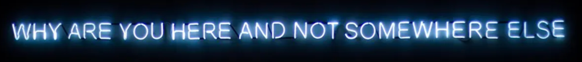


Executive Summary
Do you earn more with education?
^{Does it vary by gender?}
Notes:
Talk Track:
Why are you here and not somewhere else? We paid a notable amount of money to take this course, expecting to get exposure to the tools required to help us elevate and/or pivot our careers. Hypothesis is that education including skill advancing certifications such as this class help us achieve greater rewards, in this case monetary rewards.
Our primary goal was to answer the following questions:
Do we earn more with education?
Does it vary by gender?

Slide 4
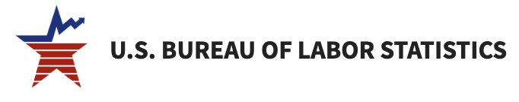




EDA Approach & Methodology
23 years
Salary
Education Level
Gender
Has the gender pay gap improved over the years?
Does it vary by education level?
Does wage growth vary by gender?
Project
Ideation
Data Sourcing & Transformation
Data
Analysis
Synthesis
-Transform data to usable format (CSV)
-Used Power BI to derive preliminary insights to confirm usability of data source
-Used Jupyter Notebook/Google Collab to build code
Notes:
Talk Track:
EDA Approach
We leveraged a US Bureau of Labor Statistics data set, spanning twenty-three years with salary, education, and gender as parameters.
The specific questions we wanted to touch upon were:
-Has the gender pay gap improved over the years? Does it vary by education level?
-Does wage growth vary by gender?
Methodology
We took the standard approach, kicking off with project ideation, and spending a bit of time sourcing data & transforming it to net out to two usable CSV files.
We then looked to quickly assess feasibility of our data set to derive preliminary insights. Once we felt comfortable with our data set, we proceeded to leverage tools available (Power BI, Python) to build/code visualizations.
We took both a top-down, bottom-up approach to come up with a narrative, synthesizing information/charts, and ensuring they answer the questions we set out to address.

Slide 5

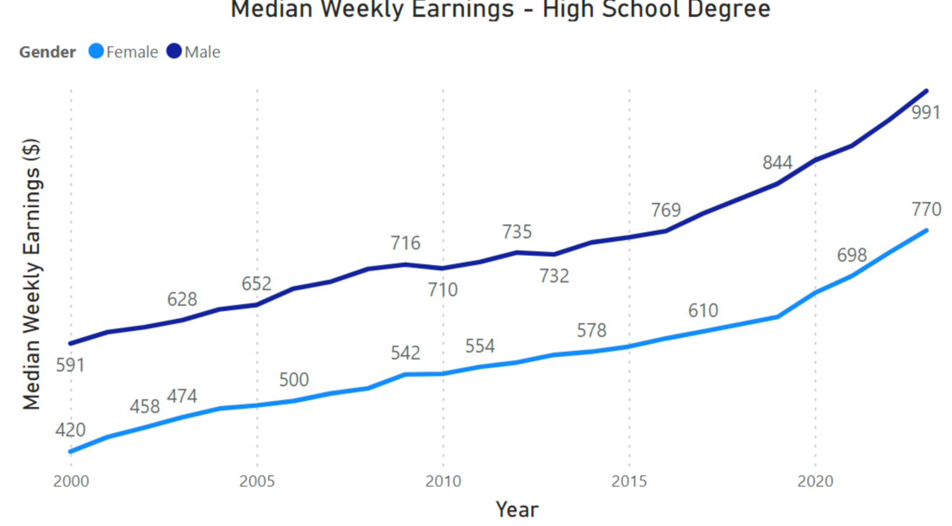
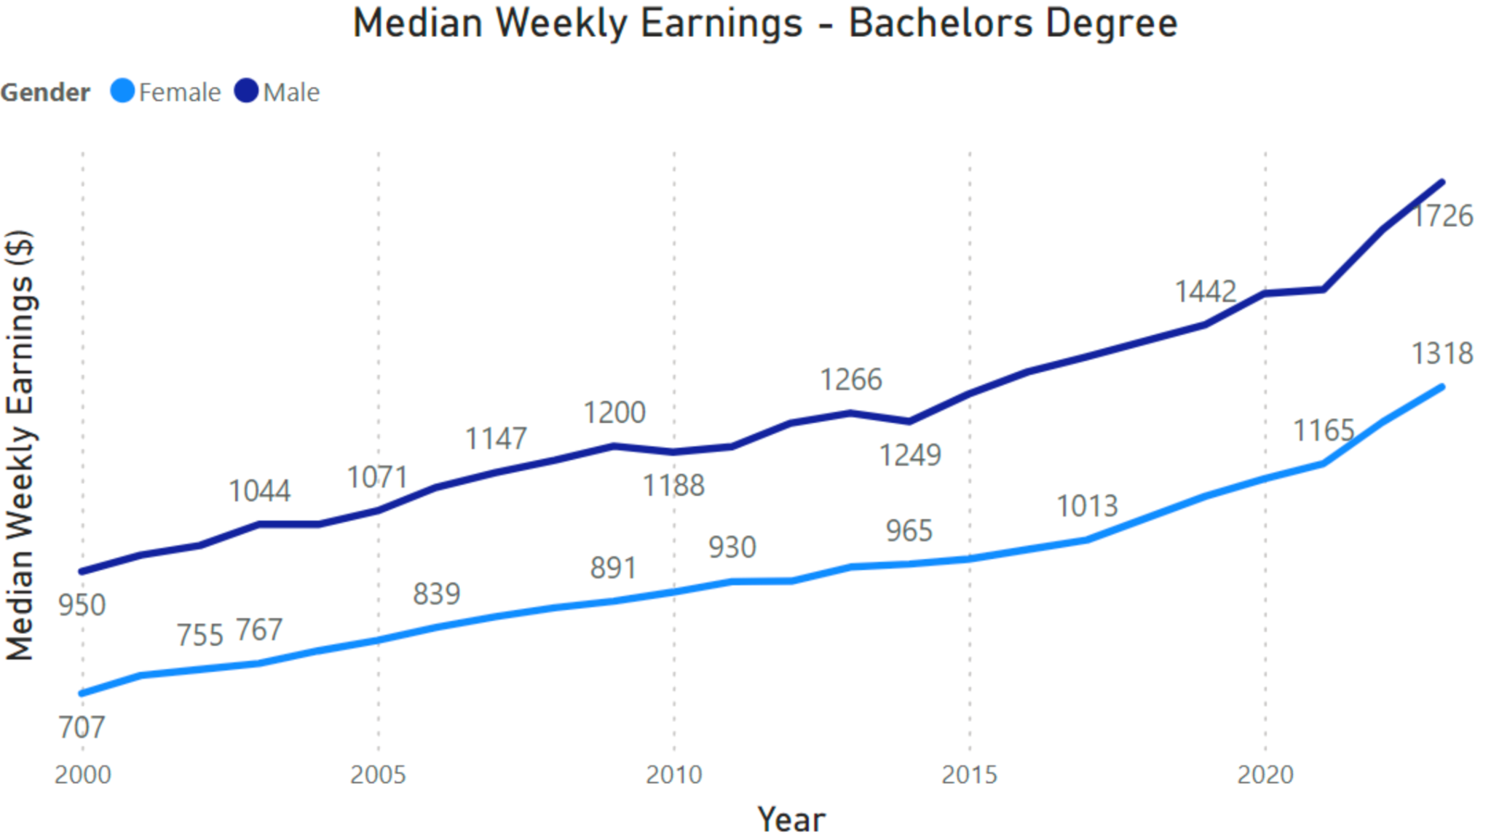
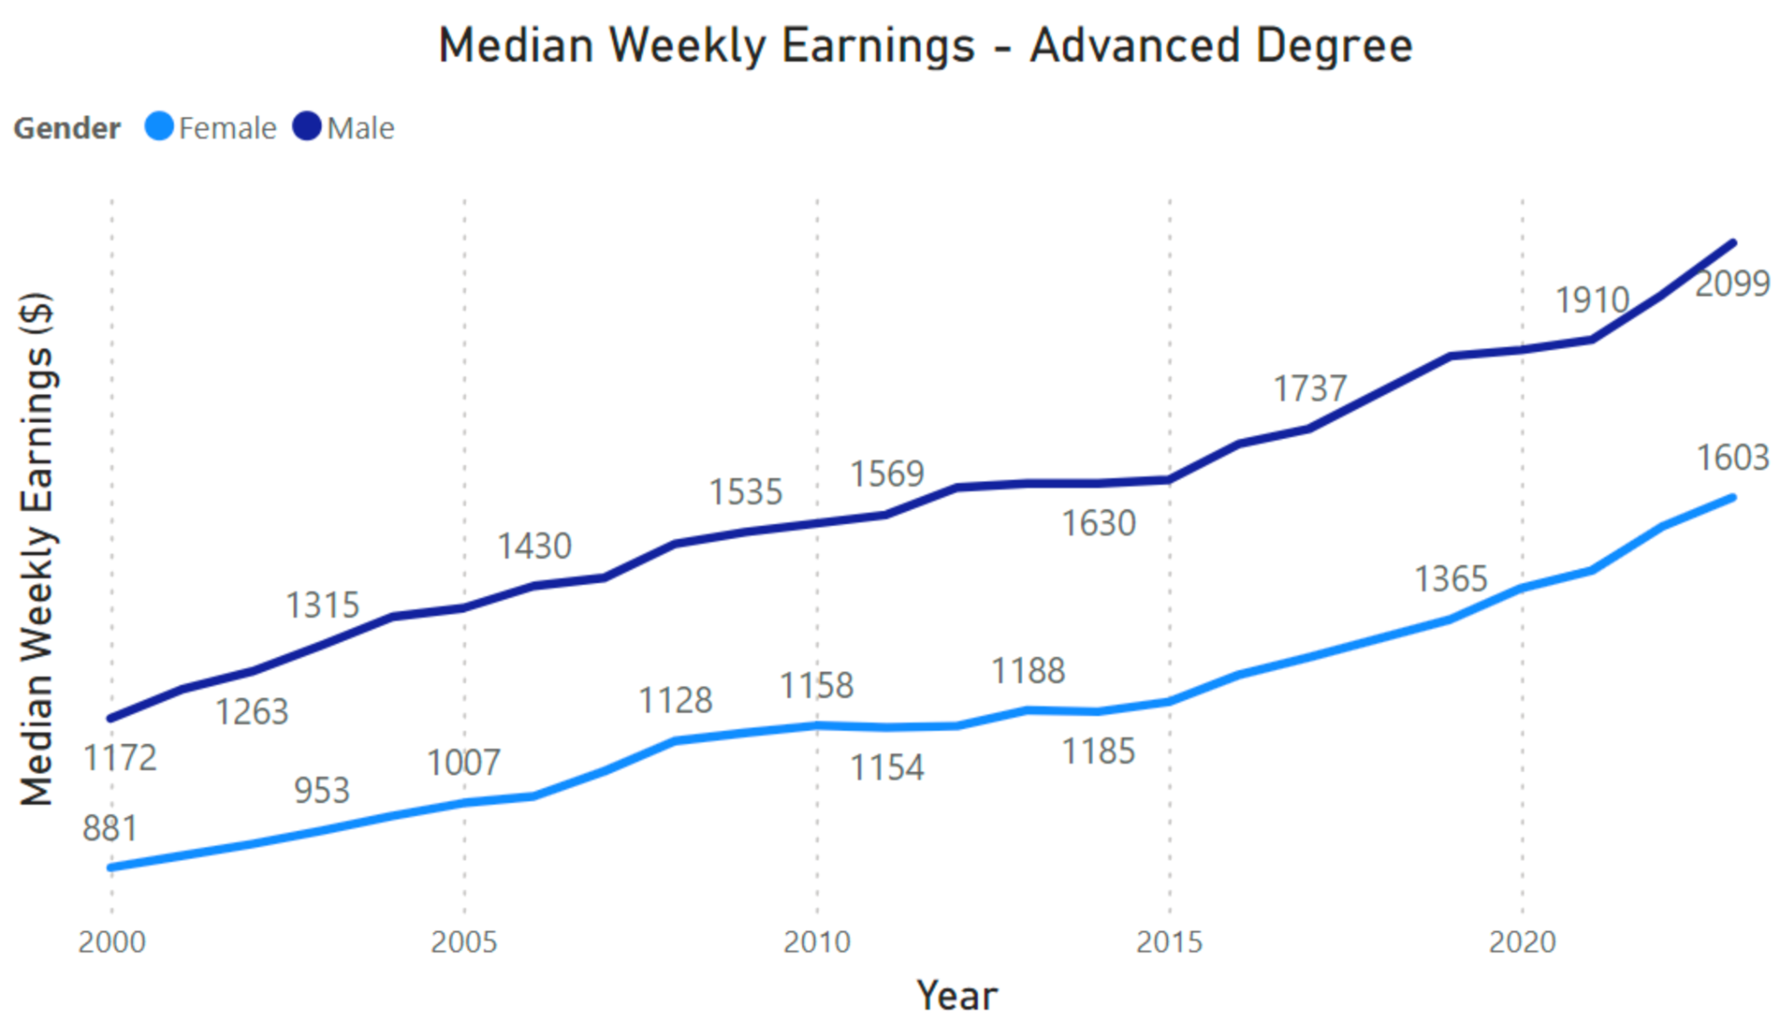
Both Men & Women Earn More With Increased Education;
While There Is A Noticeable Gender Gap In Pay Between Men & Women,
Pay Across Both Genders Are Directionally Aligned Across All Education Levels
Legend
Advanced Degree
Bachelor’s Degree Only
High School Graduates
Notes:
Talk Track:
We see that you do earn more with increased levels of educations. We also see that this is true for both men and women. What we do notice is that there is a pay gap that exists between men and women.
However, as we see in the trended charts, both male and female pay is directionally aligned across all education levels. In fact, we have confirmation that there is near perfect correlation between men and women pay.
Implication is that there is opportunity to right size pay for women by bringing awareness to pay gaps at critical steps in one’s career. For example, programs that bring awareness to pay levels for women entering the workforce (e.g., analyst classes at financial institutions) could help narrow the pay gap.

Slide 6
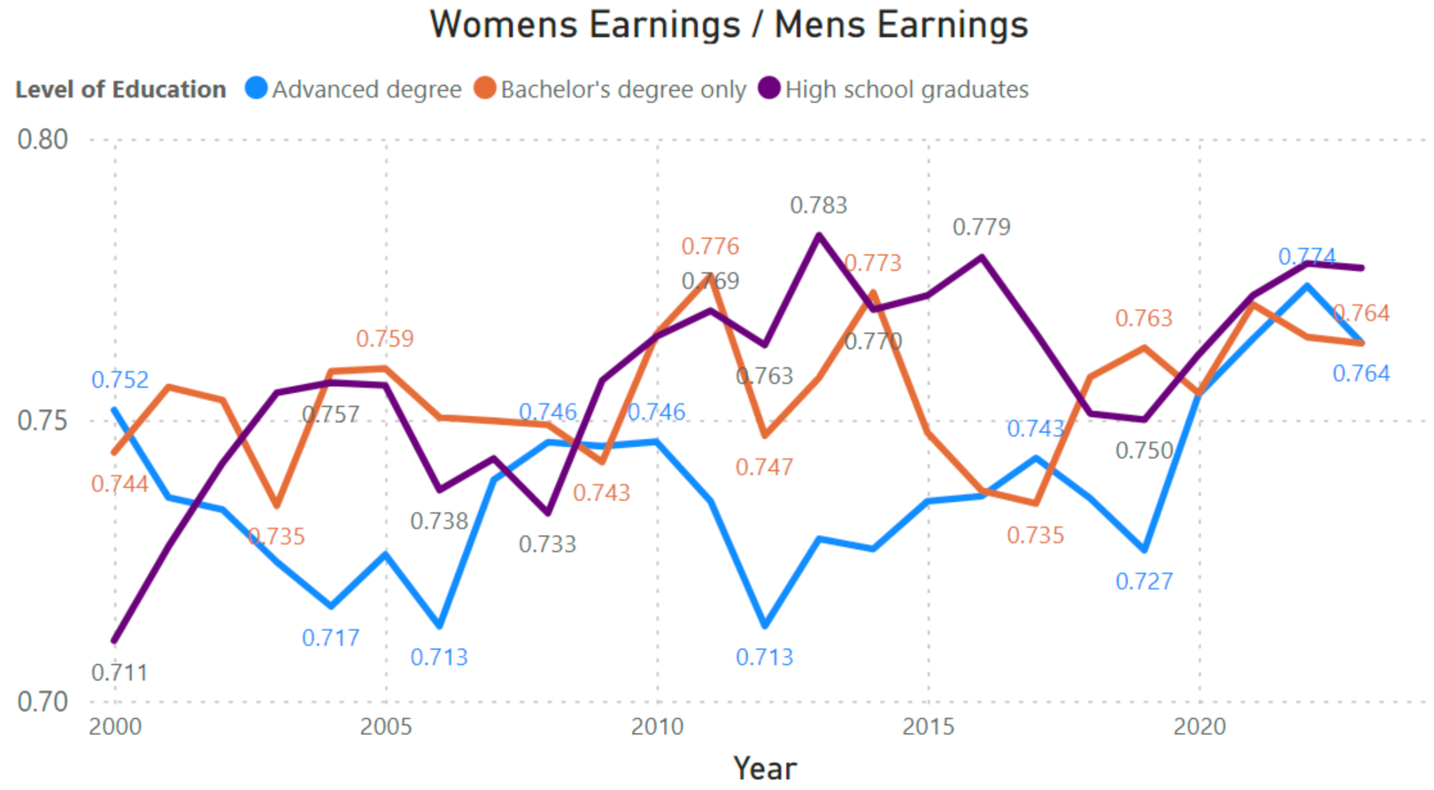
Gender Gap Is Fairly Consistent,
With Greater Gender Imparity For Advanced Degree
Earnings Of Women / Earnings Of Men
Notes:
Talk Track:
The gender gap has been fairly consistent over the past twenty-three years, with women earning within the range of $0.70-$0.80 per every dollar men make across all education levels. An interesting, and perhaps expected, observation is that the gender gap is noticeably greater for Advanced Degree. This is most likely the result of compensation packages for more specialty roles (e.g., C-suite, etc.) being more subjective with a broader range of pay than more junior/standard roles where compensation tables are more structured/rigid.
Implication here is that with more women getting higher education and more equipped to be hired to specialty/C-suite roles, effort is needed to bring awareness to the gender pay gap and ensure we make strides to bridge the gap.

Slide 7
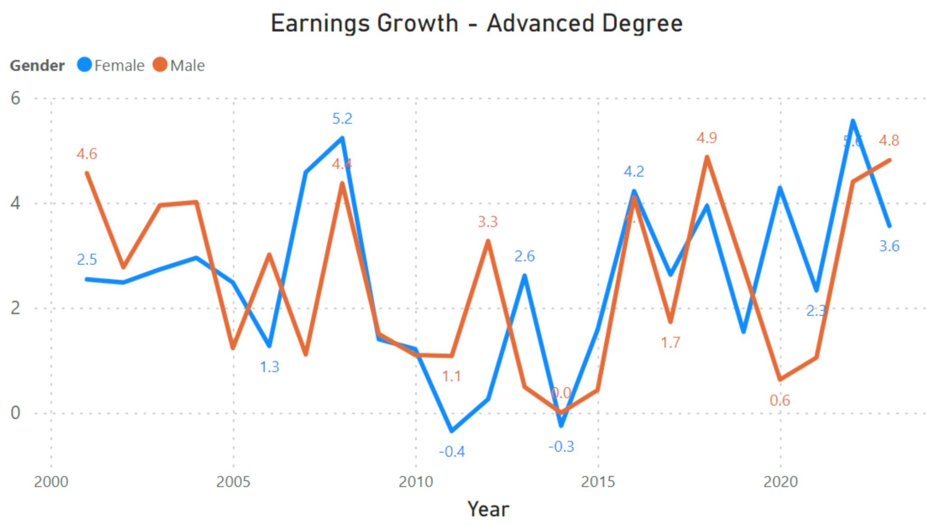
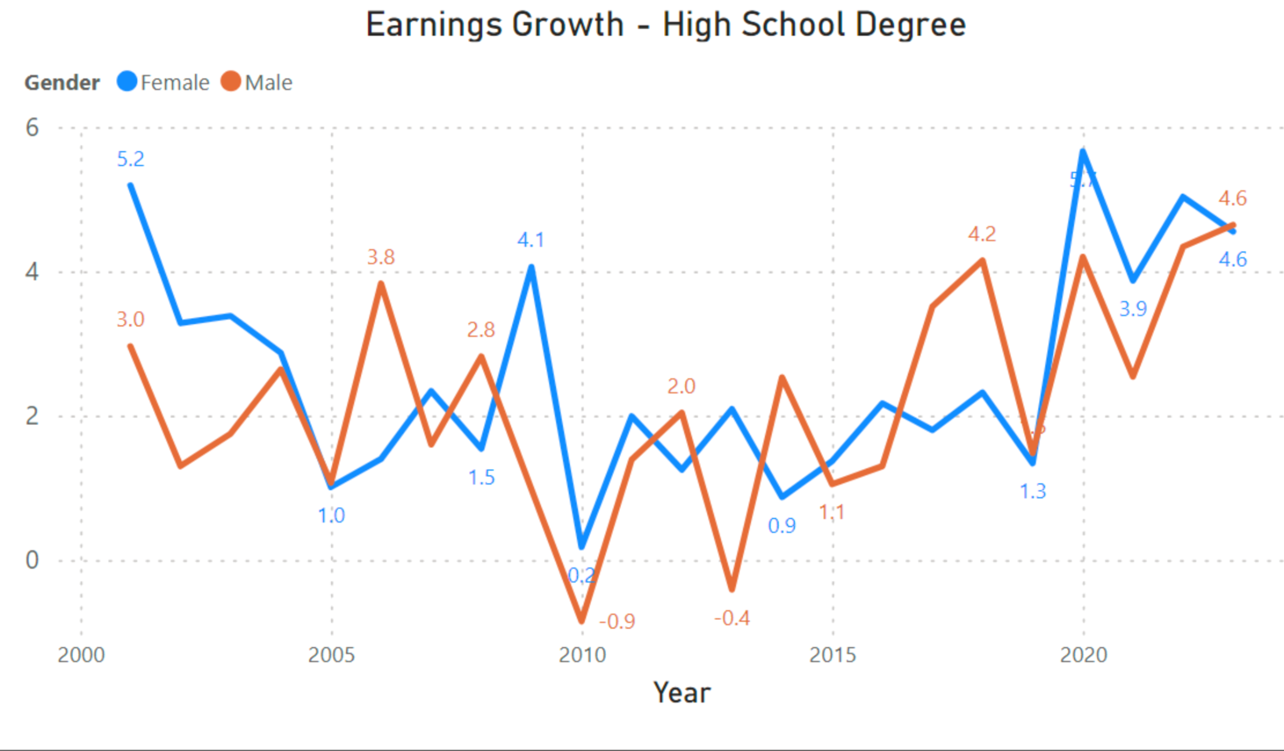
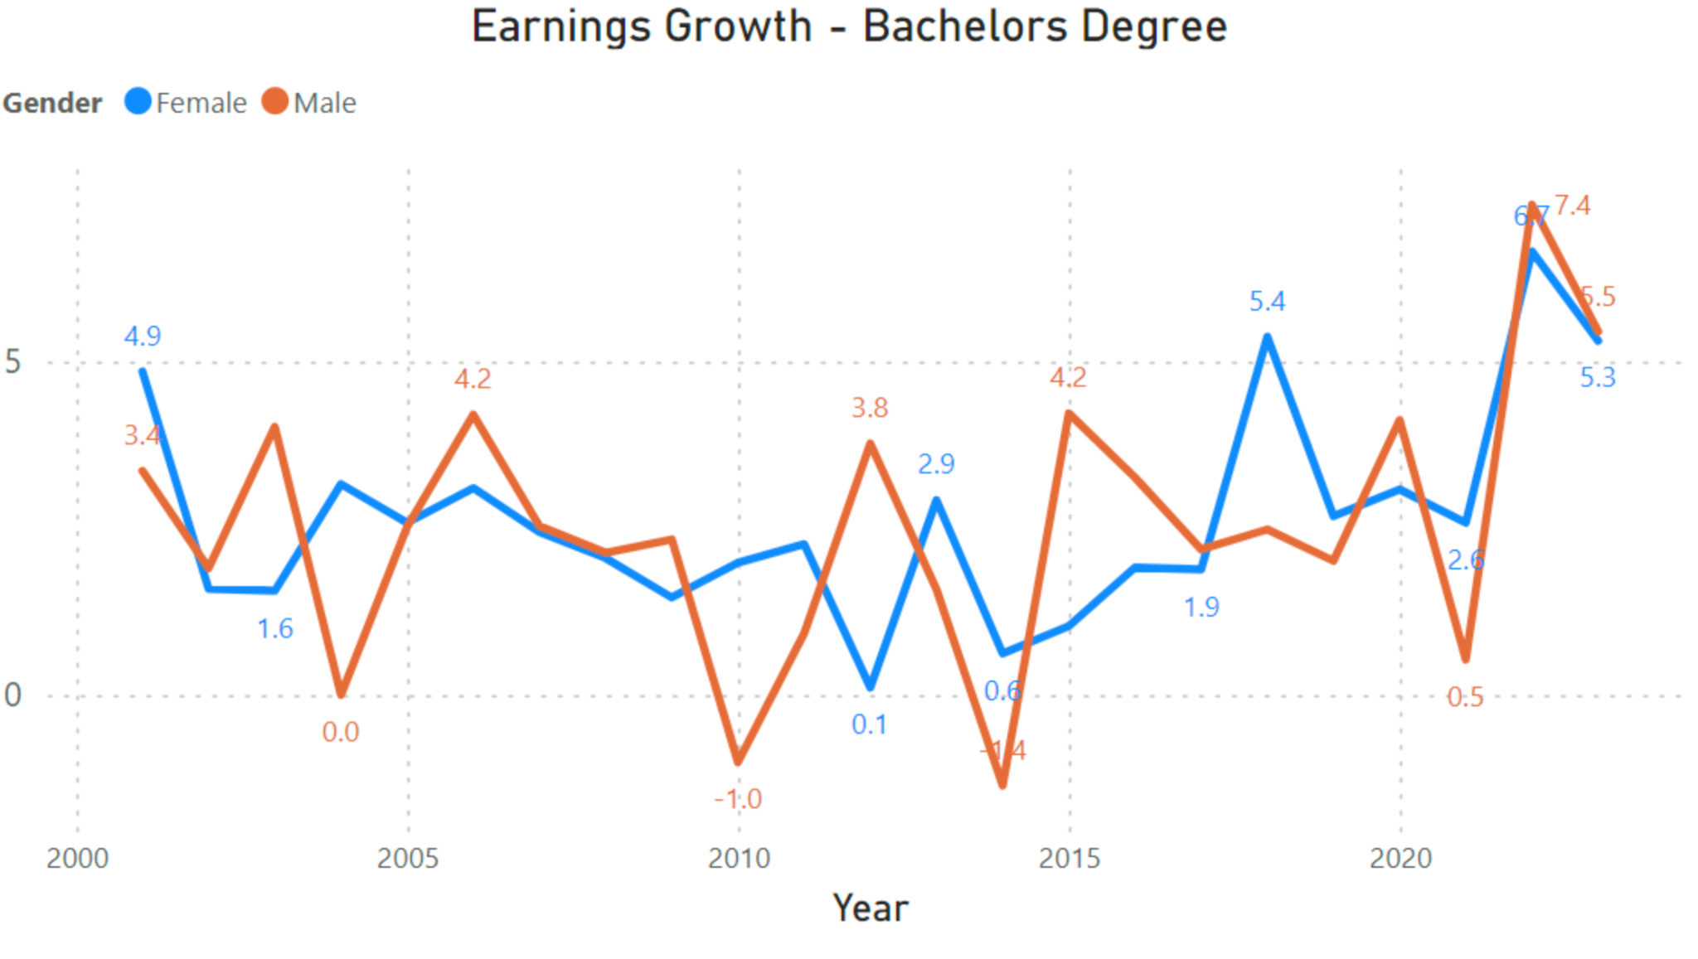
Wage Growth Seems To Be Generally Aligned Across Genders,
Perhaps Lagged For Females Across Lower Education Levels
*
Legend
Advanced Degree
Bachelor’s Degree Only
High School Graduates
Percentage
Percentage
Percentage
Notes:
Talk Track:
An interesting observation is the noticeable variance between genders in 2020 (noted by the asterisk). This variance is most likely attributed to the salary history ban that was instituted in New York, prohibiting employers from asking prospective or current employees about their salary history and compensation. Intent of this ban aimed at narrowing the gender wage gap in New York.
Implication here is that there is opportunity to make change in efforts to get to pay parity.

Slide 8
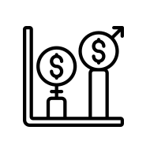
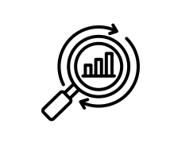
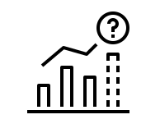

Conclusion & Next Steps
Both men & women earn more with increased education; While there is a noticeable gender gap in pay between men & women, pay across both genders are directionally aligned across all education levels
Gender gap is fairly consistent ($0.70/$0.80 F : $1 M), with greater gender imparity for Advanced Degree (compared to lower education levels)
Wage growth seems to be generally aligned across genders, perhaps lagged for females across lower education levels
Analyze additional data dimensions to get more granular insights:
Ethnicity
Profession/Industry
Age
Family Status
Geo
Build a model to forecast pay trends by various segments to help bring awareness to further make progress in achieving pay equity
Notes:
Talk Track:
In summary:
-Both men & women earn more with increased education; While there is a noticeable gender gap in pay between men & women, pay across both genders are directionally aligned across all education levels
-Gender gap is fairly consistent ($0.70/$0.80 F : $1 M), with greater gender imparity for Advanced Degree (compared to lower education levels)
-Further, wage growth seems to be generally aligned across genders, perhaps lagged for females across lower education levels
Based on the findings of this analysis, we identified some follow-up opportunities:
Analyze additional data dimensions to get more granular insights
Build a model to forecast pay trends by various segments to help bring awareness towards more effort needed to achieve pay equity

Slide 9
Thank You!
Notes:
Questions?

Slide 10
Conclusion & Next Steps
Analysis Approach
Data Profiling and Review:
Understand the raw data by profiling the data and reviewing the published data dictionary.
Opportunity Identification:
Identify opportunities for analysis and prediction within the dataset.
Data Preparation:
Prepare data for analysis by reading relevant data using Pandas.
Trend Identification:
Identify trends in data using Matplotlib libraries.
Insight Seeking:
Seek insights from the data to inform decision-making.
Prediction:
Utilize Google's Colab and 'Prophet' to predict trends based on historical data.
Conclusion Drawing:
Draw conclusions based on the analysis and predictions to inform future actions.

Slide 11
Focus Areas of Analysis
Despite encountering limitations in the quality of available data, the project team has strategically prioritized their efforts based on time and project constraints. The team's focus areas include:
National Trends in Education Levels:
Analyze trends across all education levels by degree or level of education, ethnicity, and sex.
Compare these trends to levels of income to identify correlations and insights.
Top Income Earners and Education Type:
Explore the relationship between top income earners and their respective education types.
Identify patterns and correlations to gain a deeper understanding of income generation across different educational backgrounds.
Sebastian Fajardo
Trends in Top 5 Education Avenues:
Investigate trends in the top 5 education avenues or degrees over the specified timeframe.
Assess the relative levels of income associated with these education paths to discern patterns and potential correlations.
Income Potential by Sex and Ethnicity:
Analyze income potential by sex and ethnicity within the context of education completion.
Explore competitive dynamics within the education landscape to understand disparities and opportunities.
Curve Fitting and Prediction for Unemployment Rates:
Utilize curve fitting techniques to analyze historical unemployment rates.
Develop predictive models to forecast unemployment rates for the next 12-month period, enabling proactive decision-making and resource allocation.
By focusing on these key areas, the project team aims to extract meaningful insights and actionable recommendations despite the challenges posed by the data quality and project constraints.

Slide 12
Missed Opportunities:
Due to time constraints, we were unable to leverage the available data for expanding our analysis to include correlation studies. Additionally, we had intended to explore the impact of the Covid pandemic on the employment market; however, this investigation was not feasible within the current timeframe. These analyses will be deferred for future endeavors.
To enhance our exploration of correlations between key variables, we recognize the need for additional data sources. Supplementing the labor department market data with demographic, income, or census data would enrich our analysis and provide a more comprehensive understanding of the factors influencing the employment landscape.

